Slide 1
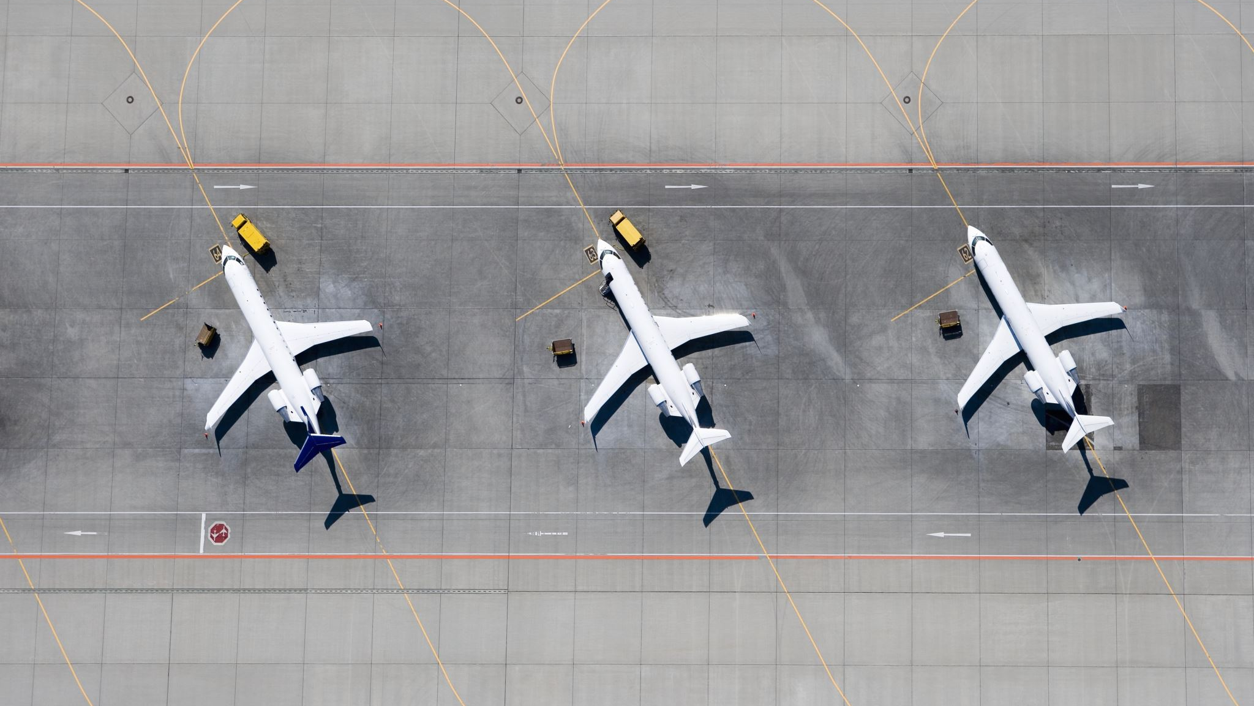
Predicting flight cancellations in advance with machine learning models

Slide 2
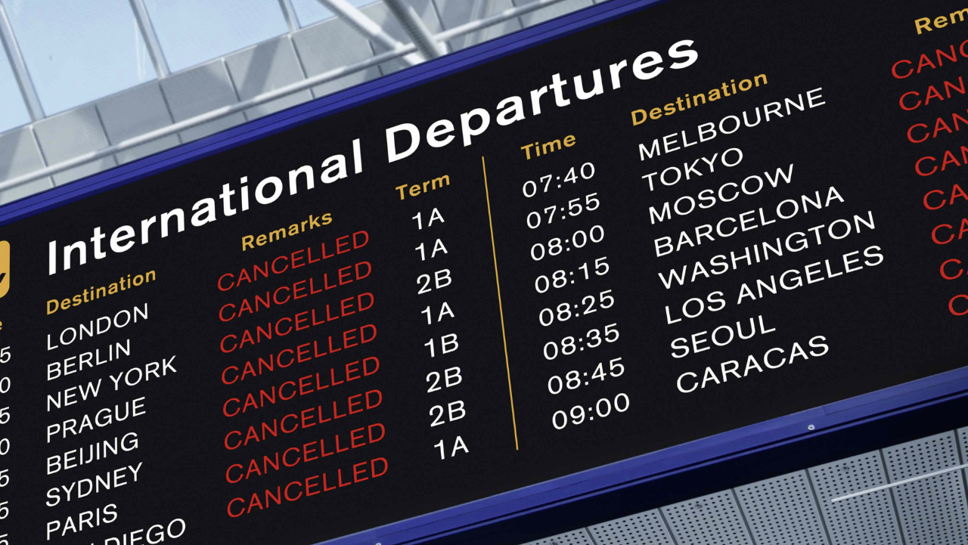
Flight cancellations does not only waste the time of travelers it may also make them lose money due to missed cruises, prepaid hotel rooms, increased parking fees, cancellation or postponement of business trips and additional cost of unplanned air tickets.

Slide 3

Problem Statement
What tool can be used by air travelers to predict flight cancellations in advance?

Slide 4

Solution
Building a model that predicts flight cancellations will serve as an important tool used by air travelers to predict flight cancellations in advance

Slide 5

Data Sources
1.The 2015 Flight Delays and Cancellations (kaggle.com) downloaded from Kaggle. It has about three files airlines.csv, airports.csv and flights.csv
2.airlinedelaycauses_DelayedFlights.csv also downloaded from Kaggle
3.The supplementary dataset was downloaded from Open data @ OurAirports
3. Supplementary dataset was downloaded from Open data @ OurAirports

Slide 6
Data Wrangling
Renaming datasets
Handling missing values
Handling abbreviated values
Handling duplicate columns
Merging
Resulting dataset
fl_delay
7755837 rows
42 columns

Slide 7
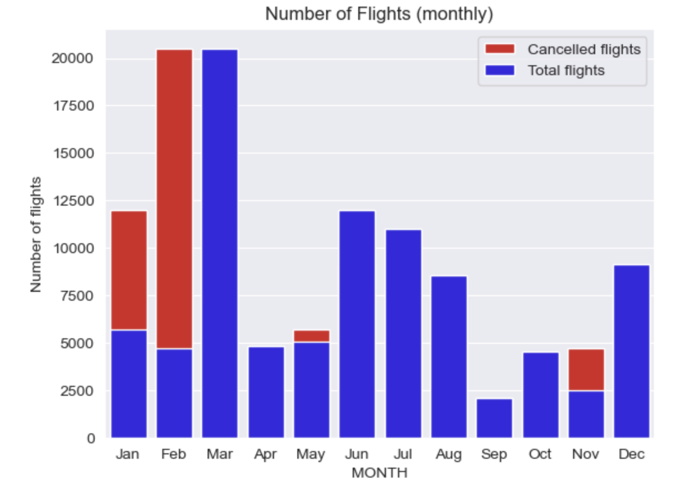
Exploratory Data Analysis
More flights were cancelled in November, January and February.
This may be due to harsh winter weather conditions.

Slide 8
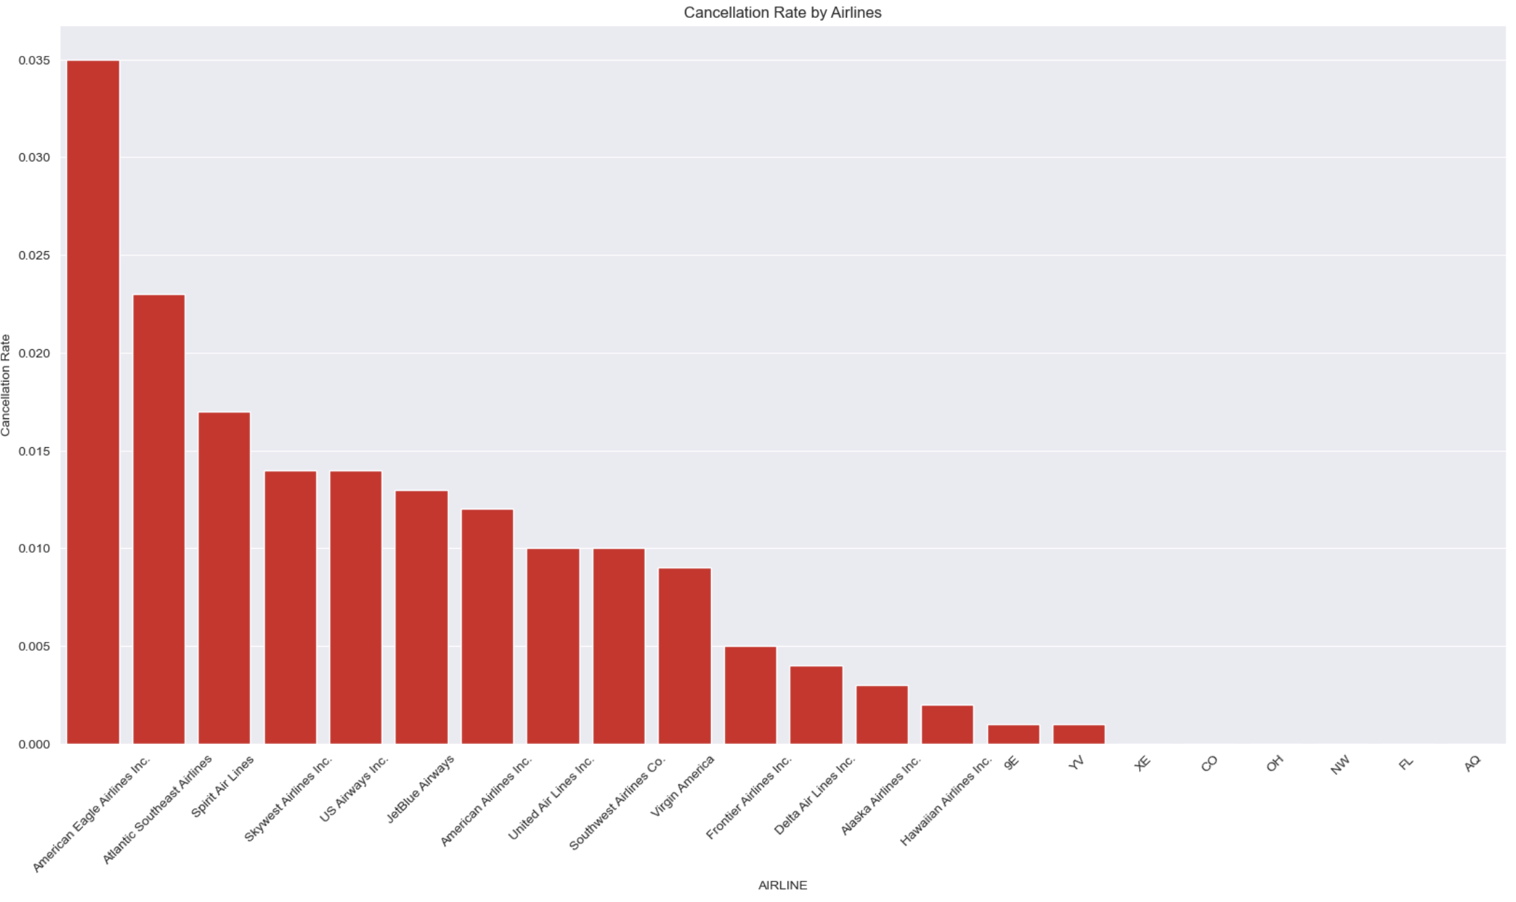
American Eagle Airlines Inc was responsible for the most flight cancellations at a cancellation rate of 3.5%.

Slide 9
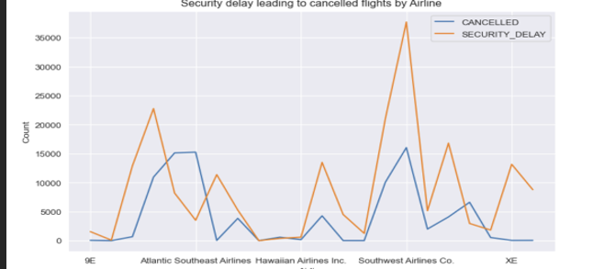
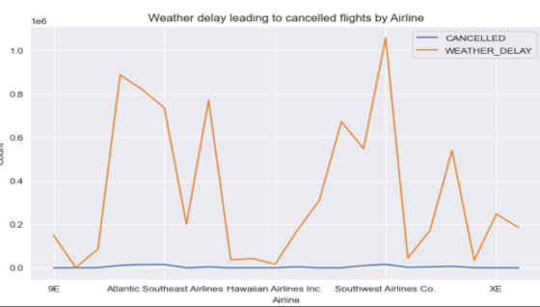
Security and Weather delays were most likely to cause flight cancellations.

Slide 10
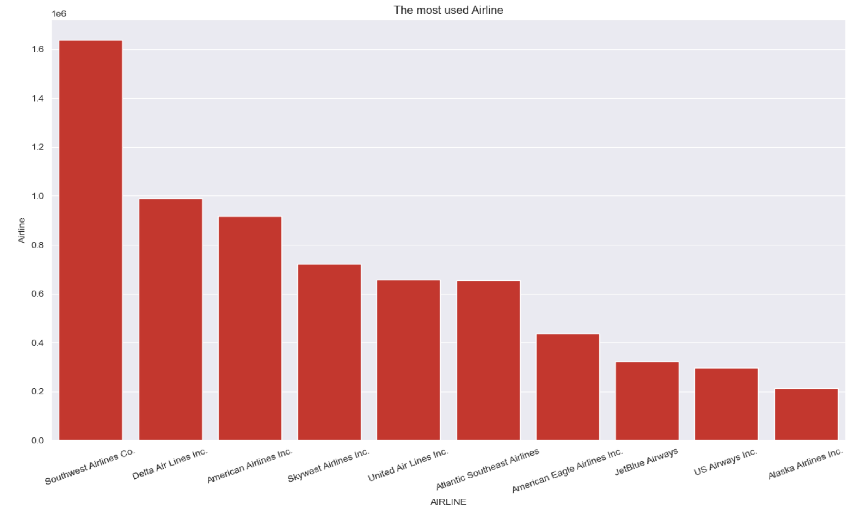
Southwest Airlines Co. has the most patronized flights

Slide 11
Preprocessing
delay features were dropped
id, ident, Cancellation reason, type, name, tail number, latitude_deg, longitude_deg, elevation_ft, iso_country, iata_code were dropped
Categorical columns like Origin and Destination airports were dropped
Airline and IATA code were encoded
X and y variables were defined
(dependent variable ‘CANCELLED’)
Data was split into training and test sets in the ratio 80:20 respectively

Slide 12
Confounding features that were dropped
Elapse time
Scheduled Arrival
Scheduled departure
Scheduled time
Airtime
Flight number
Arrival time
Departure time
Taxi in
Taxi out
Wheels off
Wheels on
Diverted

Slide 13
Modelling
Three machine learning models were built to predict flight cancellation.
Logistic Regression
Decision Tree Regressor with the max depth parameter set to 2.
Random Forest Classifier Model. The n_estimators parameter was set to 8.

Slide 14
Model parameters were adjusted to account for imbalance in data
All three model algorithms were defined as shown in the figure below

Slide 15
Model Evaluation
Due to class imbalance the f1 score and recall scores were used to evaluate models
Decision Tree has the highest F1 and Recall scores
 | Evaluation Metrics
Models | f1 train score | F1 test score | Recall test score
Logistic Regression | 0.364 | 0.364 | 0.647
Decision Tree | 0.475 | 0.475 | 0.701
Random Forest | 0.441 | 0.441 | 0.670

Slide 16
Model Evaluation- Confusion matrix
Comparing confusion matrices of models showed that,
Decision Tree model was able to identify more true predictions than LR and Rf models.
Model | True Positive | True Negative | False Positive | False Negative
Logistic Regression | 13863 | 811650 | 721379 | 4276
Decision tree | 10585 | 1.2e+06 | 311410 | 7154
Random Forest | 11301 | 1.1e+06 | 433485 | 6838

Slide 17
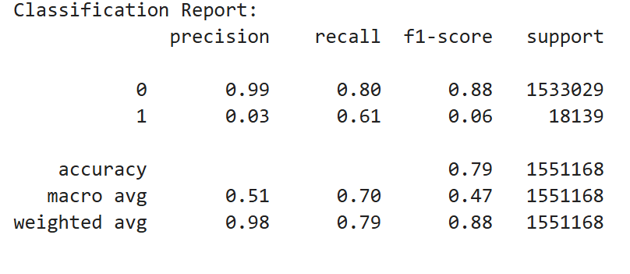
Decision Tree- Classification Reports
Classification Report of Decision Tree Classifier model showed,
The precision and f1 scores of non dominant class was less than the scores for the dominant class.

Slide 18
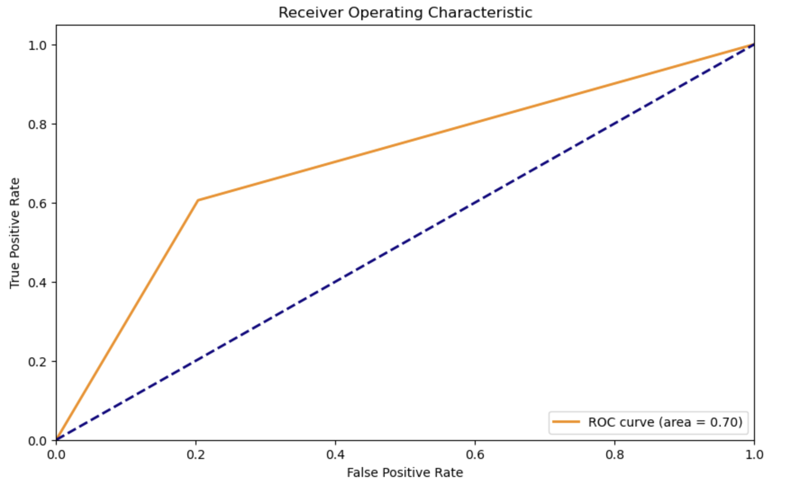
Model Evaluation ROC curve
Decision Tree ROC
The graph proves that the diagnostic ability of decision tree model is good.
The area under the curve value is 0.7.
It shows that the Dt model can rank a randomly positive instance higher than a randomly negative instance.

Slide 19

Model Selection
The best model is the Decision Tree Model

Slide 20
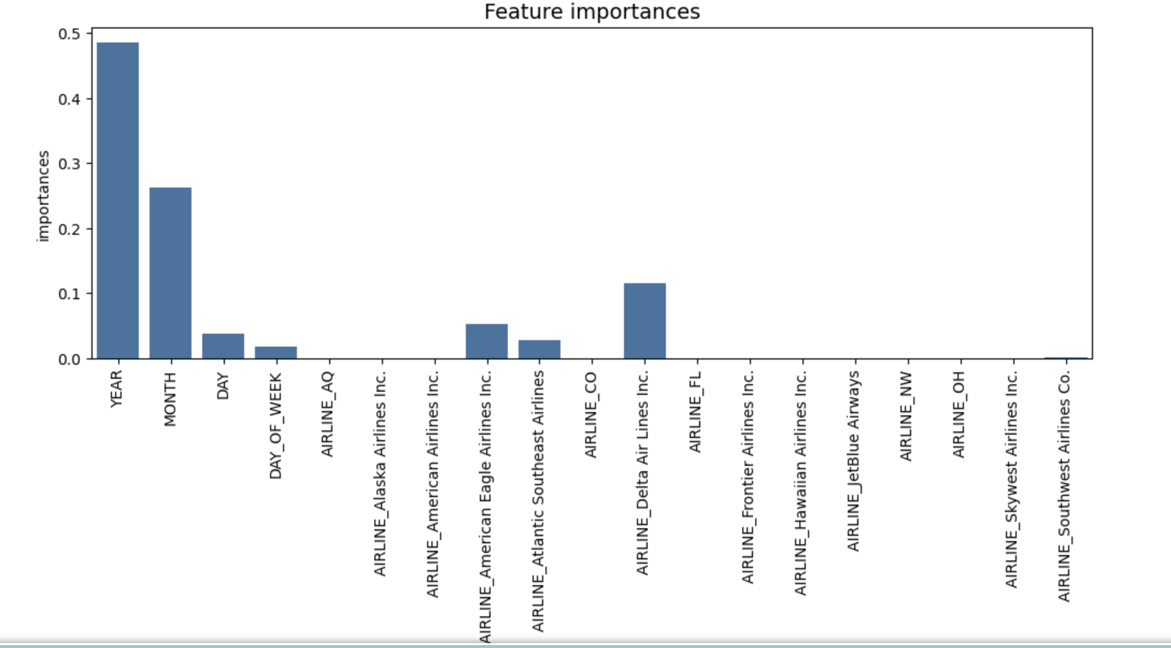
Decision Tree Model
The most important features of the Dt model are year, month and
Delta Airlines

Slide 21

MODEL LIMITATION
Dt Model found 7154 false negatives.
Highest False negatives compared to the other models
False negatives mean that model will wrongly predict flight cancellations in these
This defeats the objective of this project

Slide 22
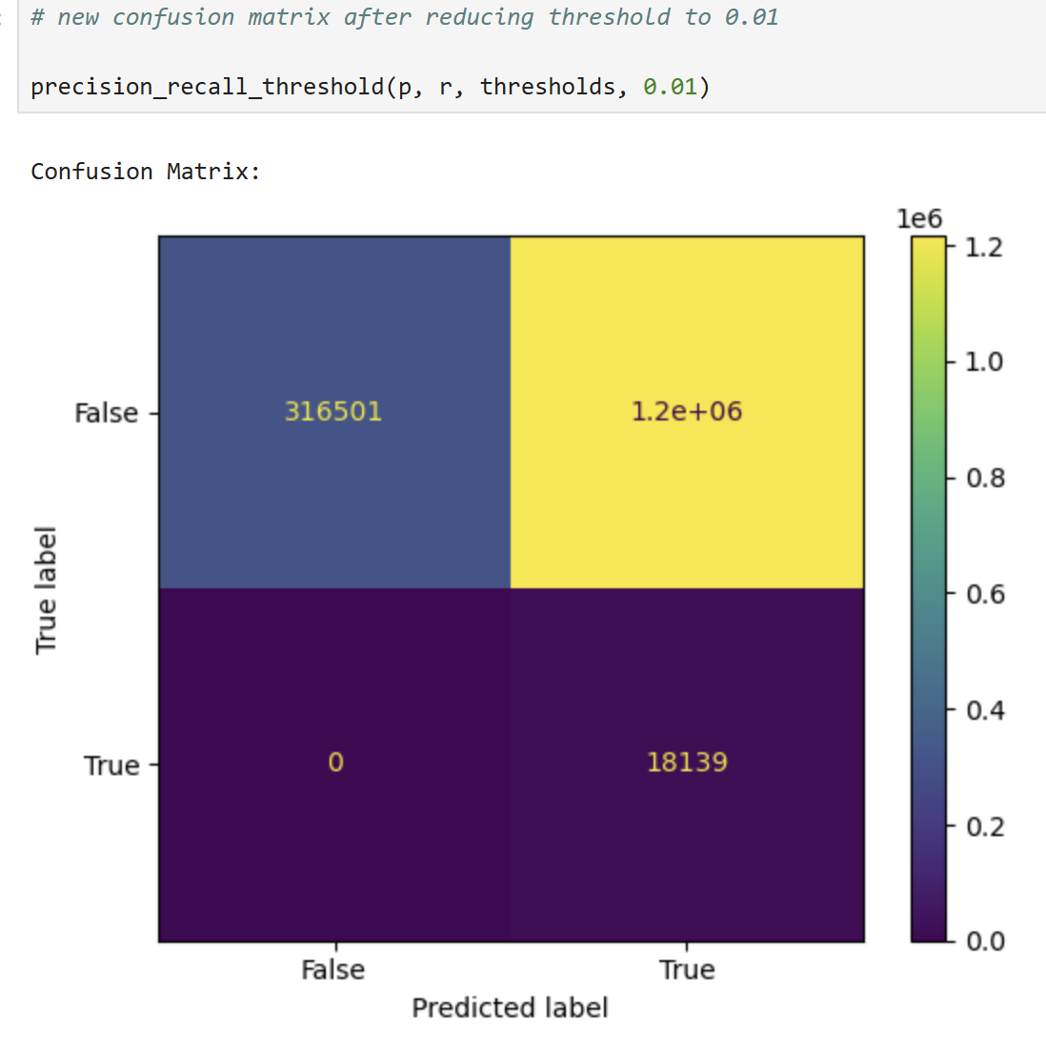
MODEL IMPROVEMENT
Model threshold line must be reduced to allow more false positives than false negatives
The effects of false positives will not lead to worse outcomes than false negatives
Threshold line reduced to 0.01.
This caused False negatives to reduce to 0 and false positive to increase to from the initial 311410 to 1.2e+06

Slide 23
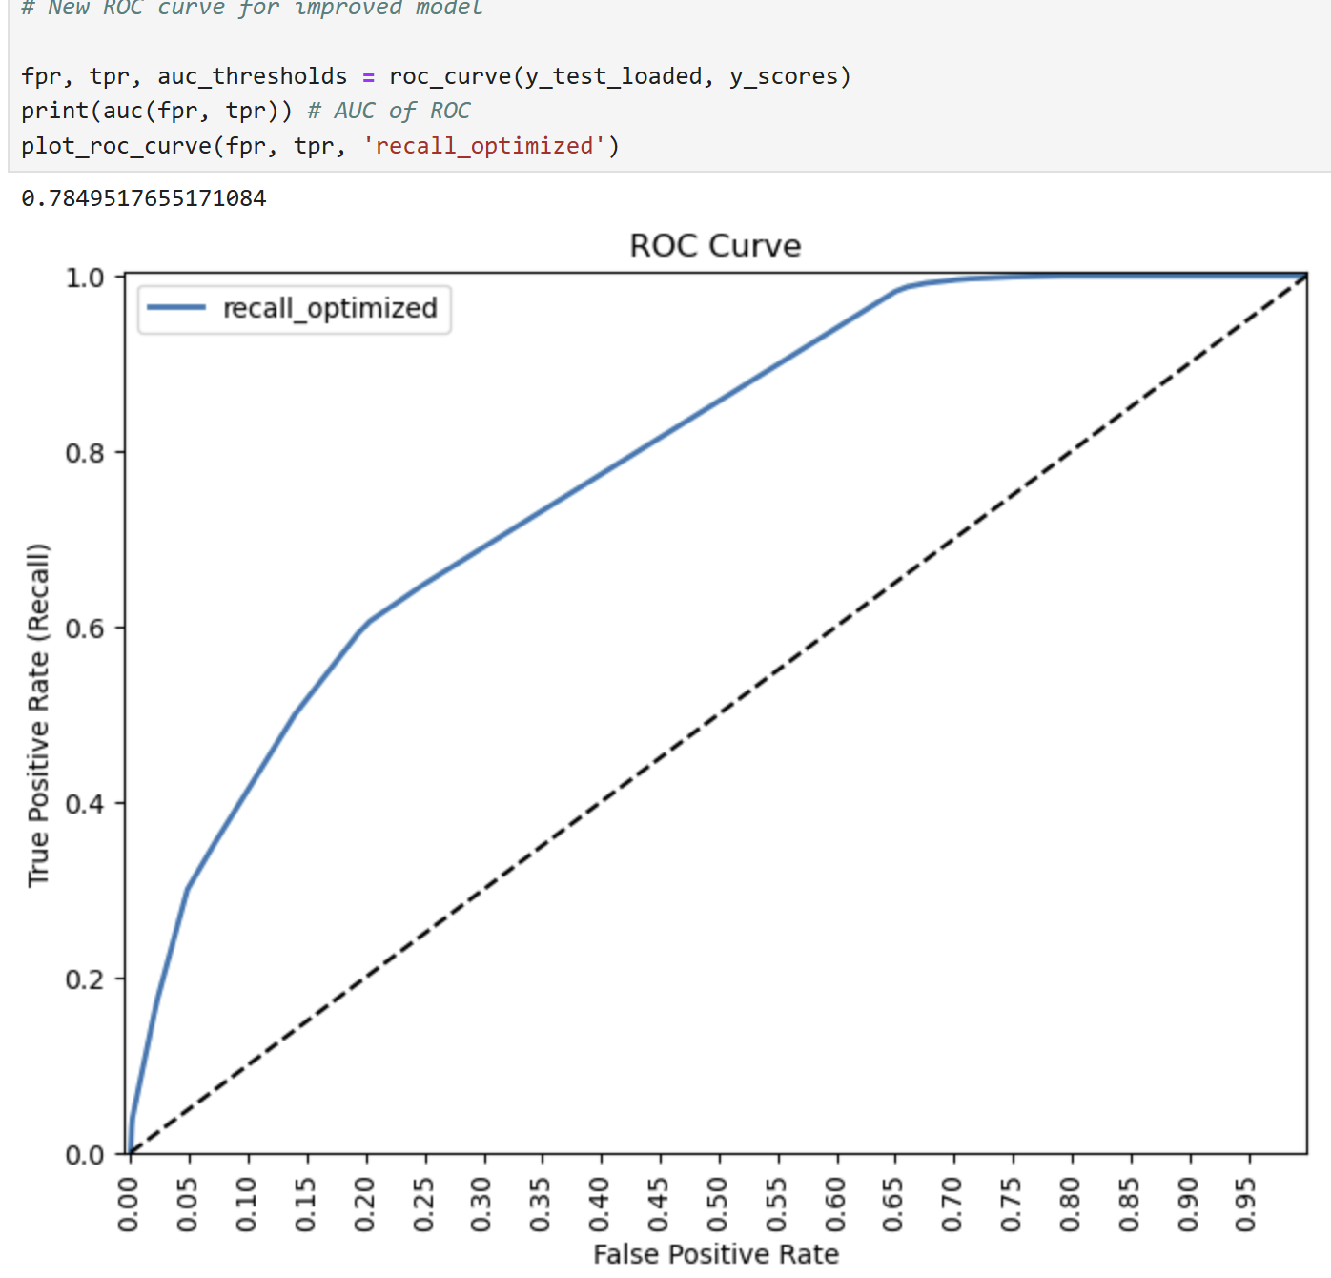
New Roc For Decision Tree Model
Area under the curve increased from 0.70 to 0.79

Slide 24

Conclusion
Decision Tree Model is the best predictive model for flight cancellations.
The most important feature for this model are Year, Month and Delta Airlines.
Reducing threshold line to from default 0.5 to 0.01 improved model by reducing false negatives from 7154 to 0.

